Slide 1
Japanese Computers
From 1981 to around 2000, there were several different flavors of 8-bit, 16-bit and 32-bit PCs being sold in Japan, with each manufacturer competing for setting a new standard of micro-computing and for higher percentage of market share.
  NEC PC-6601, PC-8801, PC-9801, PC-9821, PC-98 Note, PC98 NX
  Sharp X1, X68000
  Fujitsu FM-7, FM-77, FM-Towns, FM-Towns Marty, CAR Marty
  MSX (Various Manufacturers)

Slide 2



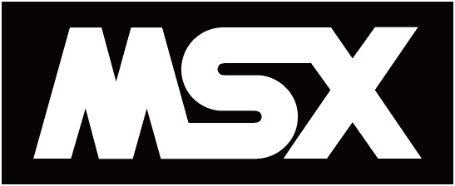
Overview
  NEC, Sharp and Fujitsu at this time were considered the “Big 3” entities that had their own lines of micro-computers, whereas MSX was more of a computer standard of hardware specifications for micro-computers that were developed by over 20+ different manufacturers.

Slide 3
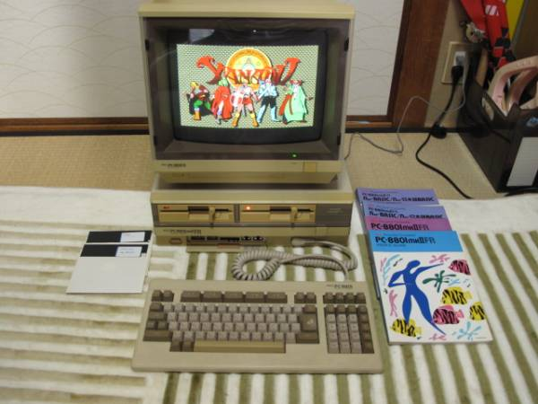
Japanese NEC Computers
NEC PC-8801 (1981 – 1990)
Operating System:
N88-BASIC,
N-BASIC (PC8800 Mode), MS-DOS, CP/M
CPU:
Zilog (Z-80), Intel 8800
4 to 8 Mhz with 64KB Ram
Graphics:
48KB（16KB x RGB3 plane)
640×200 resolution – 15Khz, 24Khz
Sound:
Beep, PSG, FM, MIDI
Most were 8-Bit with a few later models: PC88VA, VA2, VA3 being cable of 16-Bit.

Slide 4
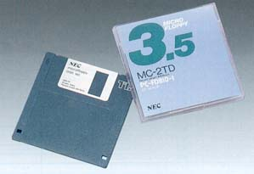
Japanese NEC Computers
What is a PC-88?
The NEC PC 8801 was the successor of PC 8001. It offered fine color graphics and had an optional MS-DOS board and was one of the fist, if not the first color CP/M computer.
It ran in three bootable modes: CP/M, MS-DOS, and N88-Basic. The N-Basic would natively boot on the system without disk, just like the PC 8001. Some also had Software / Hardware switches to turn it into PC 8001 mode.
It had a small release in the U.S. and Canada and it was distributed in west Europe by NEC Neuss Germany. They even manufactured computer furniture to be bought by complete systems. In the U.K. this was also a well know model in the marketed office equipment. The PC8801 had 2 basic interpreters in ROM, at first the bill gates written N-basic from Microsoft and second the very special Microsoft N-88 basic with extended commands for graphics etc. You could load CP/M operating system by diskette.
These systems typically had dual 5'' (2x320 KB) or
8'' (2x1 MB) floppy drive unit, and eventually 2x640KB
A special PC88VA3 was the only NEC PC ever to support
2TD 3.5" discs, triple density discs that would hold 9.3mb
and this was back in 1988 when most of us were on 5.25"
discs that held under 360K.

Slide 5
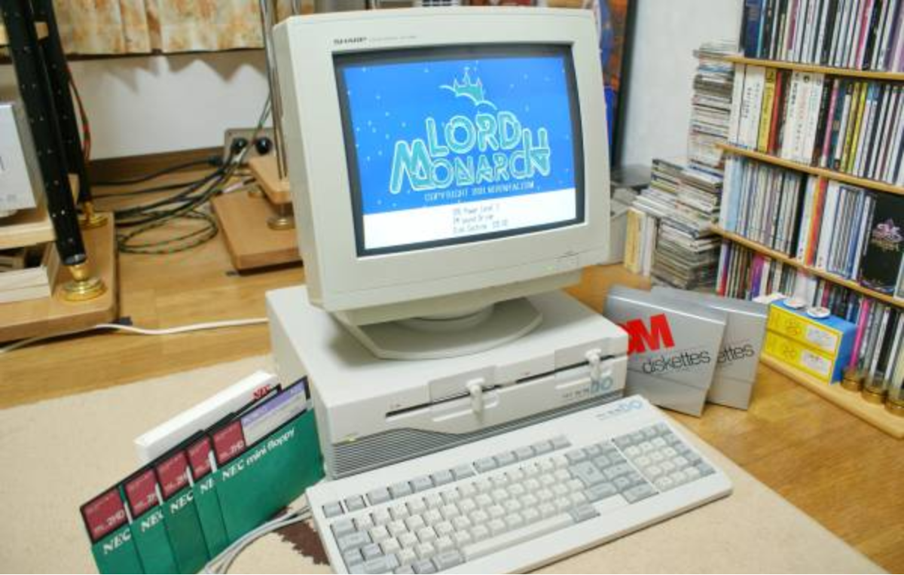
Japanese NEC Computers
NEC PC-9801 (1982 – 1997)
Operating System:
N88-BASIC, MS-DOS, BASIC, Windows 3.1, Windows 95, Windows NT, OS/2, UNIX, NetWare
CPU:
Intel 8800 series, NEC V30,
Intel 80286, 80386, 80386SX
Varies between 5 to 16 Mhz 128KB to 1MB Ram
Graphics:
640×200, 600x400 resolution
24Khz, 31Khz
Sound:
Beep, PSG, FM, PCM, MIDI
There were a few models that supported IDE and SCSI Harddrives, but most used 3.5” and 5.25” 2HD 1.25 MB.

Slide 6
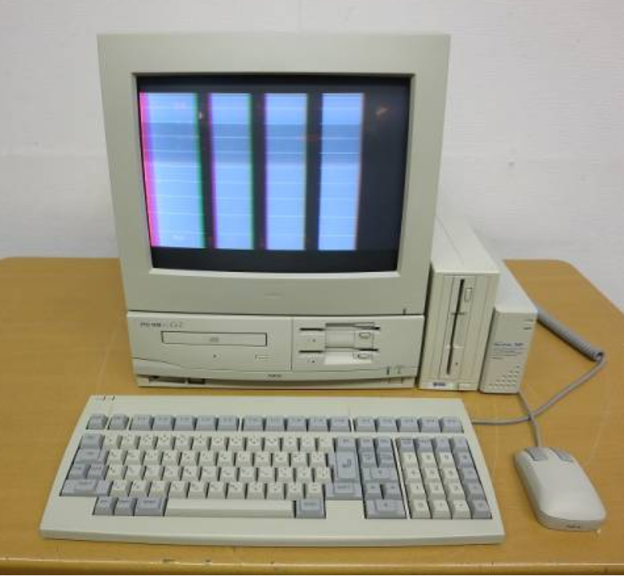
Japanese NEC Computers
NEC PC-9821 (1992 – 2000)
Operating System:
N88-BASIC, MS-DOS, BASIC, Windows 3.1, Windows 95, Windows NT, OS/2, UNIX, NetWare
CPU:
Intel 8800 series, NEC V30,
Intel 80286, 80386, 80386SX
Varies between 5 to 16 Mhz 128KB to 1MB Ram
Graphics:
640×200, 600x400 resolution
24Khz, 31Khz
Sound:
Beep, PSG, FM, PCM, MIDI
The PC9821 series often had HDD support, and some supported CD-Rom drives and RAM / CPU upgrade options.

Slide 7
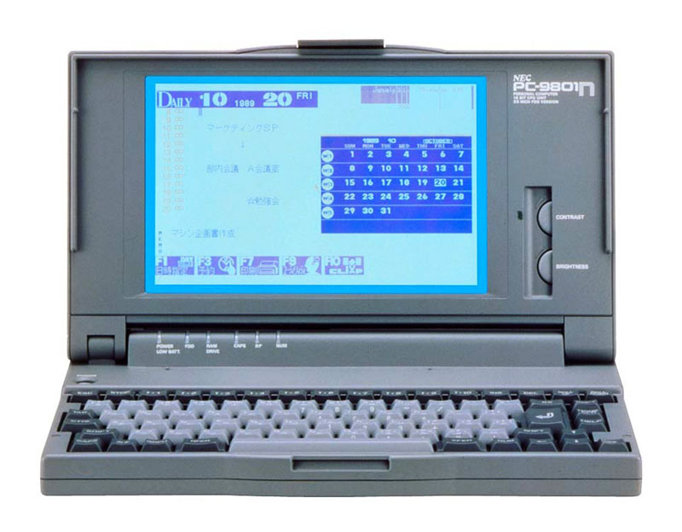
Japanese NEC Computers
NEC PC-9801N (98NOTE) (1989 – 2000)
In October 1989, NEC announced the PC-9801N under the nickname of "98NOTE".
This was an A4-binder-sized notebook computer with a weight of 2.9 kilograms.
It employed the V30, a 16-bit microprocessor, as its CPU (clock frequency 10MHz). It achieved greater compactness and lighter weight by using a slim-type floppy disk drive, liquid crystal display, keyboard and custom LSI.
1-megabyte 3.5-inch floppy drive, and a 1.25-megabyte RAM drive (memory capacity equivalent to a single floppy disk drive), so it could be used in the same way as models equipped with two floppy disk drives.
It was equipped with a liquid crystal display with backlight, capable of displaying 640 by 400 dots, with 8 colors per dot.
It was equipped standard with 640 kilobytes of user memory, and could accommodate a 2-megabyte RAM card compatible with EMS (Expanded Memory Specifications). This made it possible to also use large applications.
There were PC9801 and PC9821 “98Note” Laptops created
2 main series types: Aile and LaVie.

Slide 8
Japanese NEC Computers
What is a PC-98?
The PC-9801 was a Japanese 16/32-bit microcomputer manufactured by NEC from 1982 until November 1997. The platform established NEC's dominance in the Japanese personal computer market and by 1999, more than 18 million PC-98 units had been sold, surpassing the Commodore 64 (17 million units) as the best-selling home computer system of the 20th century.
The system has a very large library of software, consisting of more than 4,000 commercial titles and countless more doujin (indie) titles. Software and systems are difficult to find outside of Japan, even on eBay. There are a few sites however that sell the games and systems.

Slide 9
Japanese NEC Computers
History of the PC-98
The PC-98 was initially created as a higher-end business machine, but over time it eventually became popular with game developers. The PC-98 is based around Intel 8086 and compatible processors, but the design is proprietary, and it is not compatible with the IBM PC or clones, although it ran ported versions of MS-DOS, Windows 3.1, Windows 95, Windows 98 and Windows NT.
While not compatible, PC-98 architecture was still similar to that of IBM-PC such as both had 640KB conventional RAM, Intel CPUs, µPD 765 FDC, i8237 DMAC, i82591 PIC. The 16-bit bus of PC-98 (C-bus) is similar to ISA-bus on IBM-PC.
Laptop versions of the PC-9801 were also being sold in the late 1980s. The first was the PC-98 LT, one of the first mass-market laptops, released in 1986. It is considered the world's first major laptop PC. The world's first notebook computer was released in 1989, NEC's UltraLite. By 1990, the 32-bit PC-9801 NC model became the world's first laptop/notebook computer with a color TFT LCD display.

Slide 10
Japanese NEC Computers
In the early 1980's, the PC-9801 was more advanced than Western computer platforms. The PC-98 featured the first dedicated computer GPU chip, the NEC 7220 GDC, along with a 16-bit NEC CPU. It featured higher VGA display resolutions (initially up to 640x475 pixels, then up to 1024x1024 in 1983, and then up to 1120x750 pixels by 1985) in order to more accurately display Japanese text, a wider color palette (16 colors displayed out of a 4096 color palette), Yamaha FM synthesis sound chips for higher-quality audio, and a modem for online internet access.
NEC attempted to introduce the NEC PC-9801 in North America, where it was re-branded as the NEC APC in 1982. NEC, the largest semiconductor company of the 1980s, marketed the APC III as the most powerful computer on the market and more reliable machine than leading competitor IBM's PC platform, with the APC III offering twice as much speed (8 MHz), storage (720 KB floppy disks) and resolution (640x400 pixels) at around the same price. Despite the superior hardware compared to its competitors, the APC III eventually failed to make in impact in North America, largely due to the rise of IBM PC clones, which also negatively impacted IBM's share of the North American PC market.
While the NEC APC was unsuccessful in North America, it became successful in the Asia-Pacific region, particularly in Australia.

Slide 11
Japanese NEC Computers
Rivalry with Sharp X68000 and FM Towns in Japan
The PC-98 was later technically surpassed by fellow Japanese rivals Sharp and Fujitsu when they launched their own more powerful 16/32-bit computers, the Sharp X68000 and FM Towns, in 1987 and 1989, respectively.
In response, the PC-98 began using 32-bit Intel CPU processors from 1987 and supported the CD-ROM format from 1989. While both rival computers were capable of more advanced, arcade quality graphics (especially in the X68000's case) and/or greater multimedia features (in the FM Towns' case), neither computer platform was able to dethrone the PC-98 as the Japanese computer market leader.

Slide 12
Japanese NEC Computers
3D graphics cards and rivalry with IBM-compatible PC's in Japan
Just as IBM-compatible PC's were on the rise in the mid-1990s, NEC came back by releasing the first 3D graphics accelerator cards on the market, initially for the PC-98. In 1995, NEC released the first 3D graphics card, the PC-FXGA (PC-FX Game Accelerator), exclusively for the PC-98. This allowed the PC-98 to produce the most advanced 3D graphics seen on a home system up until that time, with a polygon rendering performance surpassing the PlayStation console and even rivaling the then upcoming Nintendo 64; in contrast, rival early 1996 3D graphics accelerators for IBM PC clones, such as Creative Labs' 3D Blaster and NVIDIA's NV1, were unable to rival the PlayStation's 3D graphics.
The PC-FXGA was originally intended for both the PC-98 computer and the PC-FX console, with as a homebrew development kit for the PC-FX console, allowing the PC-98 to play PC-FX games. However, the PC-FX console lacked the 3D graphical capabilities of the PC-FXGA card, due to the FXGA's HuC6273 graphics chip (originally intended for the PC-FX) never actually being used by the PC-FX console.

Slide 13
Japanese NEC Computers
Decline of the PC-98
The PC-98 would continue to dominate the Japanese computer market until the late 1990s, when the arrival of Microsoft Windows 95 made it possible for IBM-compatible PC's to accurately output Japanese text, leading to the rise of IBM-compatible PC's in Japan and marking the end of the 'Golden Age' of Japanese computer gaming.
By the end of the 1990s, the PC-98's dwindling market share as well as NEC's greater support for the growing IBM PC market eventually led to the PC-98 slowly losing ground to IBM-compatible PC's. In 1997, the PC-98 NX became one of the first computer platforms produced in line with the PC97/PC98 (Not to be confused with PC-98…) System Design Guide standard, which would later become the worldwide standard for IBM-compatible PC's. As a result, PC-98 standards eventually merged with IBM-compatible PC standards, bringing an end to the traditional PC-98 platform by the early 2000s, succeeded by IBM-compatible PC98 NX computers which are still manufactured through to the present day.

Slide 14
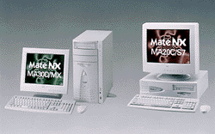
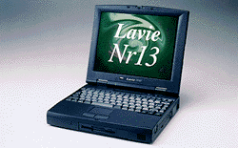
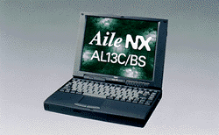
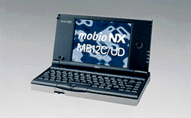
Japanese NEC Computers
NEC PC98NX Series (1997– Present)
In October 1997, NEC announced the PC98 NX series of 26 lines consisting of 200 models split between the enterprise, consumer, and portable markets. The series’ architecture was based on the Microsoft PC 97/PC 98 system design:
PC 97 Hardware Design Guide, v. 1.0, August 30, 1996. © 1996 Microsoft Corporation.
PC 98 System Design Guide, Version 1.0, September 5, 1997. © 1997 Microsoft Corporation and Intel Corporation.
*Note the difference between the terms, PC-98 and PC98 as these newer NX machines no longer supported many older software titles from PC-9800 due to now-incompatible hardware.

Slide 15
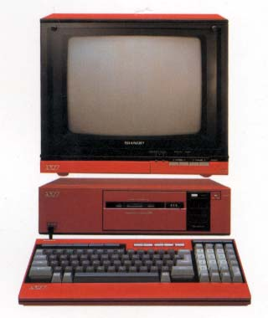
Sharp Computers
Sharp X1 (1982 – 1988)
Operating System:
Hu-Basic (Loaded from Cassette Tape)
CPU:
Sharp Zilog (Z-80A) 4 Mhz with 64KB Ram, 4-48K VRAM
Graphics:
320×200, 640×200 resolution
640×400 (X1 Turbo series)
Sound:
Beep, PSG, FM, MIDI
The entirety of the VRAM memory was mapped on to the I/O area, so it was controlled without bank change. Since X1 had these features, it was very powerful for game software.

Slide 16
Sharp Computers
What is a Sharp X1?
The X1 was a series of micro-computers released by the Sharp Corporation intended mostly for the home market.
Originally there was a bit of a upset with its release since it was a surprise product released shortly after the Sharp MZ series by the Television Division.
The X1 did not have a BASIC ROM, and it had to load the Hu-BASIC (Partnership between Hudson Software) interpreter from a cassette tape. On the plus side however, this concept meant that a free RAM area was available that was as big as possible when not using BASIC.

Slide 17
Sharp Computers
What is a Sharp X1?
The X1 was generally thought of as a better gaming machine than it’s rival, the PC-8801 and obtains a cult following particularly those interested in Shmups (Shoot’em ups).
The RGB display monitor for the X1 had a television tuner, and a computer screen could be super-imposed on TV. The X1 Twin came with an integrated NEC PC Engine and HuCard slot (Another instance of Hudson Soft’s partnership).

Slide 18
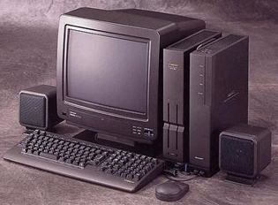
Sharp Computers
Sharp X68000 (1987 – 1993)
Operating System:
Human68k (Developed by Hudson Soft similar to MS-DOS)
NetBSD (X68030), OS-9
CPU:
Motorola MC68000 10 Mhz
1MB Ram
Motorola MC68030 25 Mhz
4MB Ram
Graphics:
1024x1024 resolution with 768x512, 512x512, 512x256, 256x256 selectable
15, 24, 31kHz up to 65,535 colors as a cable ready television (NTSC-J)
Sound:
Beep, PSG, FM, MIDI
Optional 80MB SCSI HDD
Since the system's release, software such as Human68k, console, SX-Window C compiler suites, and BIOS ROMs have been released as public domain and are freely available for download.

Slide 19
Sharp Computers
What is a Sharp X68000?
A 16-Bit computer released around the same time as the Amiga and Atari ST. Originally released in 1987 with a 10MHz 68000 CPU and 1MB RAM, the series finished six years later with a 25MHz 68030 series which had 4MB RAM and a 80MB HD. Earlier models used SASI (Shugart Associates System Interface) which was a forerunner to SCSI, and is almost pin compatible with early SCSI drives. Later models used real SCSI. The series favored soft-eject 5.25" floppies though there were a few "Compact" releases with 3.25" drives and smaller cases.
One of the most striking things about the system was the case - a twin tower design bisected by a click-in/out carrying handle, reminiscent more of a mainframe computer than a PC. It was one of the first computers to feature soft-on power, where the main power supply was always on and the front-mounted power switch would only signal the machine to shut down, giving software time to save, shutdown and usually fade out the sound and the screen.

Slide 20
Sharp Computers
What is a Sharp X68000?
Two expansion slots closely related to the ISA standard, and a host of ports as standard: 2 MSX compatible joystick ports, parallel, serial, external floppy (It could run 4 drives, two were built-in) port, 3D goggles port, as well as TV/monitor control, SASI, headphone, microphone, RGB in and out... Very advanced for the time, and in terms of design.
In terms of hardware, it was very similar to arcade machines of the time, and served as the Capcom CPS system development machine. It supports separate text RAM, graphic RAM and hardware sprites. Sound was produced internally via Yamaha's then top-of-the-line YM2151 FM synthesizer and a single channel OKI MSM6258V for PCM. Due to this and other similarities, it played host to many near-original arcade game ports in its day.
Capcom produced a converter that was originally sold packaged with the X68000 version of Street Fighter II′ that allowed users to plug in a Super Famicom or Mega Drive controller into the system. The adapter was made specifically so that users could plug in the Capcom Power Stick Fighter controller into the system.

Slide 21
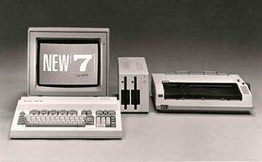
Fujitsu Computers
FM-7 / 77 (Fujitsu Micro 7) (1982 – 1988)
Operating System:
Fujitsu Disk Basic , OS-9, FLEX
CPU:
2 x MC68B09 2Mhz
MBL68B09 8Mhz (FM77)
with 64KB Ram, 48KB VRAM, 48KB ROM
Graphics:
640×200 resolution, 8 colors
Sound:
Beep, PSG 3
The F-BASIC was an enhanced version of Microsoft’s Color BASIC. BASIC. The additions to the standard Microsoft CoCo BASIC include Japanese characters, block graphics, three-voice music, the ability to have graphics appear on the default text screen, and the abilility to take any string and print it out in various sizes (from tiny to huge) and directions (forward, backward, up, down, etc.).

Slide 22
Fujitsu Computers
What is a FM-7?
The FM-7 was originally a stripped down version of an earlier released business grade FM-8. As such it is sometimes referred to as the FM-8 Jr and though is removed it’s costly “Bubble Memory” it received a more advanced sound synthesizer which was favored by users of the system making it more dominant than the FM-8 model.
In 1984 the FM New7 was released without too many improvements over the original and had the same features.
Also in 1984 was the release of the of the FM-77, a higher end version of the FM-7 with an 8 Mhz processor, 128kb ram, more colors in lower resolutions and an upgrade to the VRAM up to 144kb. The FM-77 was also fully backwards compatible to the FM-7’s library of software.

Slide 23
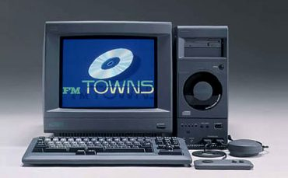
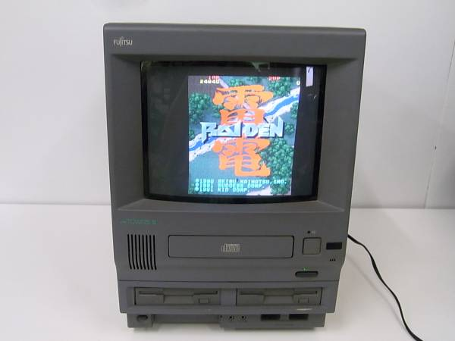
Fujitsu Computers
FM-Towns (1989 – 1997)
Operating System:
Windows 3.0/3.1/95, Towns OS, Linux, BSD, Debian, Gentoo, GNU
CPU:
Intel 80386DX 16Mhz
with 2MB up to 64MB Ram
Graphics:
320x200, 640x480 resolution
16 to 32,768 simultaneous colors
(possible 4096 to 16.7 million)
1024 x 16x16 sprites
15 kHz, 31 kHz
Sound:
FM, PCM, Wave / Red Book Audio

Slide 24
Fujitsu Computers
What is a FM-Towns?
Started as a proprietary PC variant intended for multimedia applications and PC games, but later became more compatible with regular PCs. The FM Towns included a CD-ROM drive as a standard component that featured bootable CD-Roms for software as well as being able to boot a an OS through a “hidden C” ROM drive that contained MS-DOS files and needed Realtime CD-Rom drivers, along with a mouse-driven OS, 24-bit color, and PCM sound.
With its hardware-level sprite support, the FM Towns was as capable a game machine as the X68000. By 1991 Fujitsu had 8.2% market share, just under Seiko Epson. By 1995 this stake had more than doubled, giving Fujitsu second place to NEC.
Fujitsu was also successful in convincing Western developers such as Psygnosis, Infogrames, and LucasArts to port their games to the FM Towns. To this day, these FM Towns ports remain the definitive versions of games like Zak McKracken and the Ultima series.

Slide 25
Fujitsu Computers
What is a FM-Towns?
Games on the FM Towns regularly used Red Book (audio CD standard) orchestral music tracks, especially if they were designed specifically for the Fujitsu system (games ported from the PC9801, for instance, might have used only PCM/FM music). This was a novel innovation, far ahead of other PCs of the time, made possible by the CD-ROM drive in every FM Towns computer.
The FM Towns was capable of booting its Towns OS, a graphical OS, straight from CD in 1989, two years before the boot-from-CD capable System 7 was released for the Macintosh (which provided a full graphical environment, primarily for running diagnostics and disk maintenance utilities), and a full 7 years before Windows 95B OSR2 was released for IBM PC compatibles (which did not provide a graphical OS environment besides basic installation facilities).

Slide 26
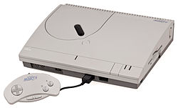
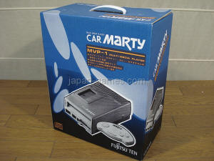
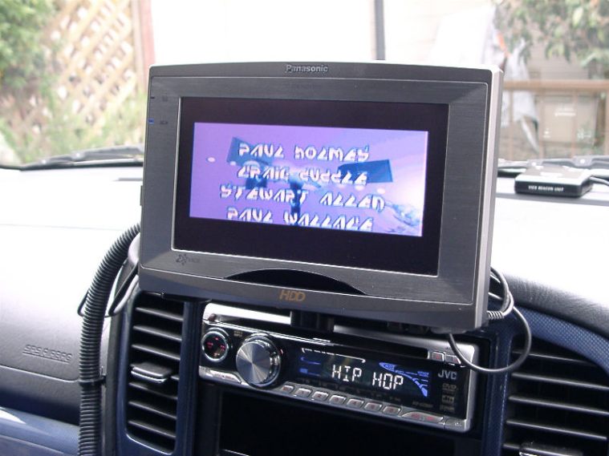
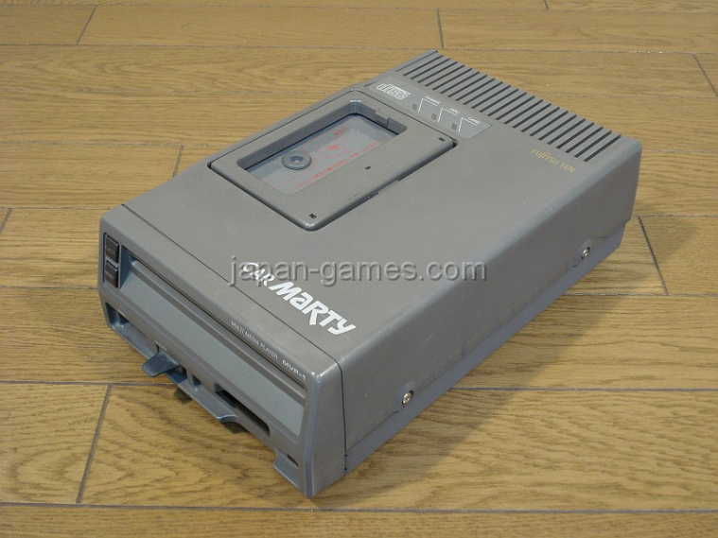
Fujitsu Computers
FM-Towns Marty and Car Marty (1993 – 1995)
Operating System:
Windows 3.0/3.1/95, Towns OS, Linux, BSD, Debian, Gentoo, GNU
CPU:
32-bit AMD 386SX 16Mhz
with 2MB up to 64MB Ram
Graphics:
352x232, 640x480 resolution
256 colors out of 32,768
Sound:
FM, PCM, Wave / Red Book Audio

Slide 27
Fujitsu Computers
What is a FM-Towns Marty?
The Marty was the first 32-bit home video game system, and came complete with a built in CD-ROM drive and disk drive. It was based on the earlier FM Towns and offered backwards-compatibilty with older FM Towns games.
Although the Marty was more of a console than a computer, it still offered a great deal of the same features that could be accessed via a FM-Towns and supported a mouse, keyboard and gamepad, as well as a PCMCIA type 1 slot that could be mapped to a drive letter and used as a small drive.
Despite having excellent hardware from a gaming perspective, both the FM Towns and the FM Towns Marty were very poor sellers in Japan. They were expensive and the custom hardware meant expandability wasn't as easy as with DOS/V (IBM PC Clones with Japanese DOS or Microsoft Windows) systems. NEC's PC98 series computers were also dominant in Japan when the FM Towns Marty was released, making it difficult to break out before the DOS/V invasion took control of the Japanese market.

Slide 28
Fujitsu Computers
What is a FM-Towns Car Marty?
In 1994 the Car Marty was introduced, which was the world’s first car multimedia system ever made. It included built-in navigation system (VICS) with audio and video guidance (first In-Car GPS) and could play the entire library of FM-Towns software.
The system could be detached from the car and played at home with a home adapter and power plug.
It was the most expensive video game console ever made, at a ridiculous price of 300,000 yen at release, which was roughly $3000. If this were adjusted for inflation today, this would have been closer to $5000 to $6000.

Slide 29
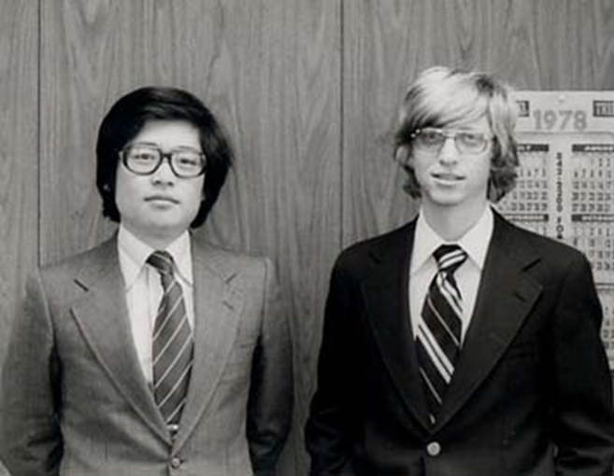
What is MSX?
MSX is the name of a standardized home computer architecture introduced by Microsoft in 1983.
It was conceived by Kazuhiko Nishi, then Vice-president at Microsoft Japan and Director of ASCII
Kazuhiko Nishi
Bill Gates

Slide 30
What is MSX?
Under the MSX Standard, hardware and software are compatible among multiple brands and models.
Nishi proposed MSX as an attempt to create a single industry standard for home computers. Inspired by the success of VHS as a standard for video cassette recorders.
Many Japanese electronic manufacturers along with GoldStar, Philips and Spectravideo built and promoted MSX computers.
Any piece of hardware or software with the MSX logo on it was compatible with MSX products of other manufacturers.
In particular, the expansion cartridge form and function were part of the standard; any MSX expansion or game cartridge would work in any MSX computer.

Slide 31
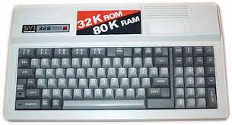
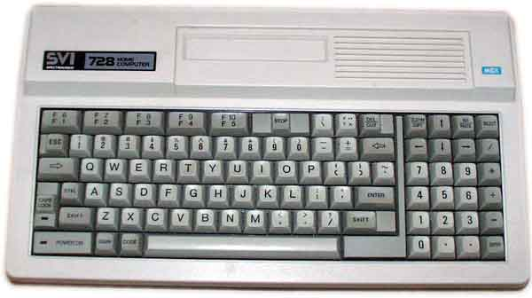
MSX first generation architecture is based on the Spectravideo SVI 328 design.
Kazuhiko Nishi modified the SVI-328 design to make it more expandable.

Slide 32
MSX1 Basic specs
Zilog Z80 CPU at 3.58MHz.
Texas Instrument TI9918/9928 graphic processor (TI-99/4a and Coleco)
AY-3-8910 PSG sound processor (similar to Atari ST)

Slide 33








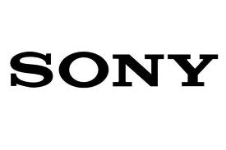


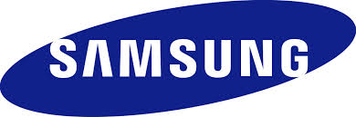



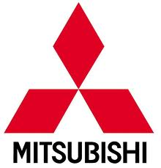



What is MSX?
It was adopted by most electronic manufacturers in Japan and Korea.

Slide 34
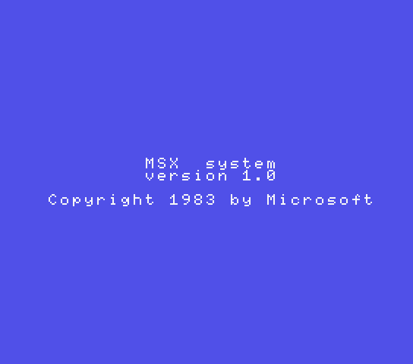
Its ROM includes Microsoft’s MSX basic 1.0.
The MSX basic contains advanced features to take advantage of the Hardware (Sprites, Play, Sound, Interrupts commands…)

Slide 35
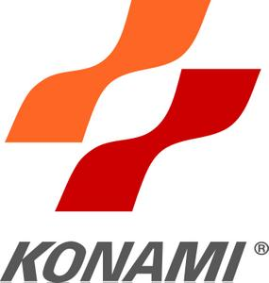
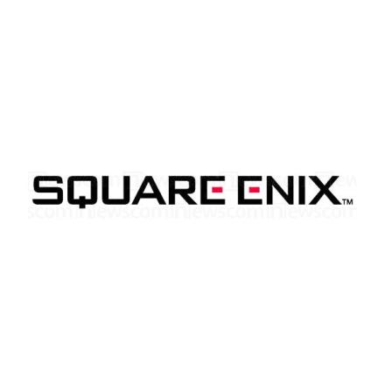
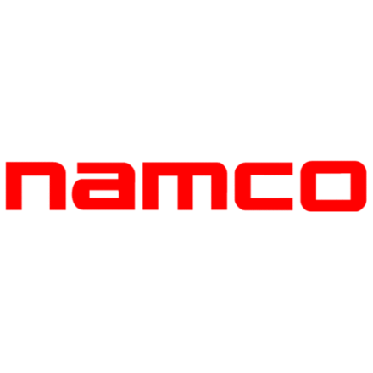

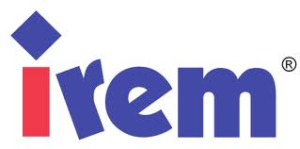


MSX Software
MSX quickly became a success in Japan and a major platform for software development.
Many Japanese software companies still active today have developed titles for the MSX.

Slide 36
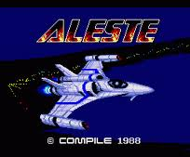
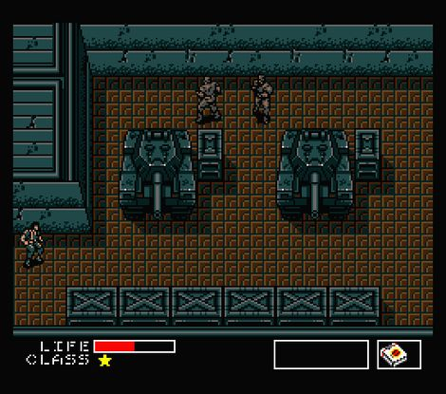
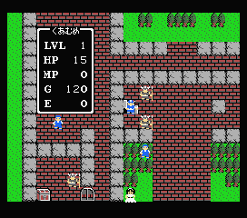
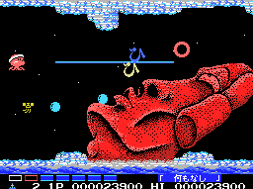
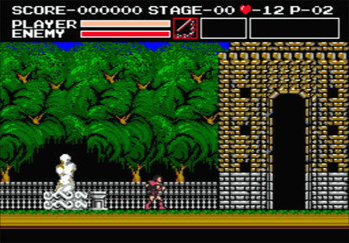
MSX Software
Several popular video game franchises were initially established on the MSX:
Dragon Quest
Castlevania / Vampire Killer
Metal Gear
Parodius
Aleste
And many others

Slide 37
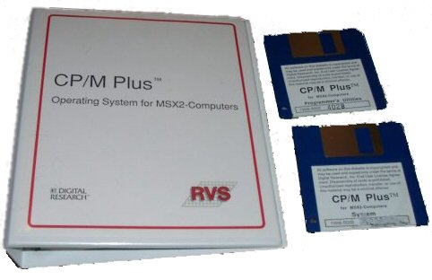
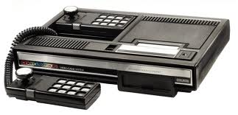
MSX Software
The MSX architecture allows compatibility with CP/M.
MSX DOS system is a cross between CPM and MS-Dos1.0. using a FAT-12 compatible storage system.
MSX is technically very similar to popular game systems like the Sega SG-1000 and COLECO providing the MSX from the start with a wide array of software.

Slide 38
MSX Models
Although all MSX are based on the same specs, each manufacturer developed numerous models (300+) with extensions based on their specialties.
Those extensions were compatible with all MSX models.
Example: Laserdisks, Music Keyboard, Light Pen, Robots, Graphic tablets, Graphic cards.

Slide 39
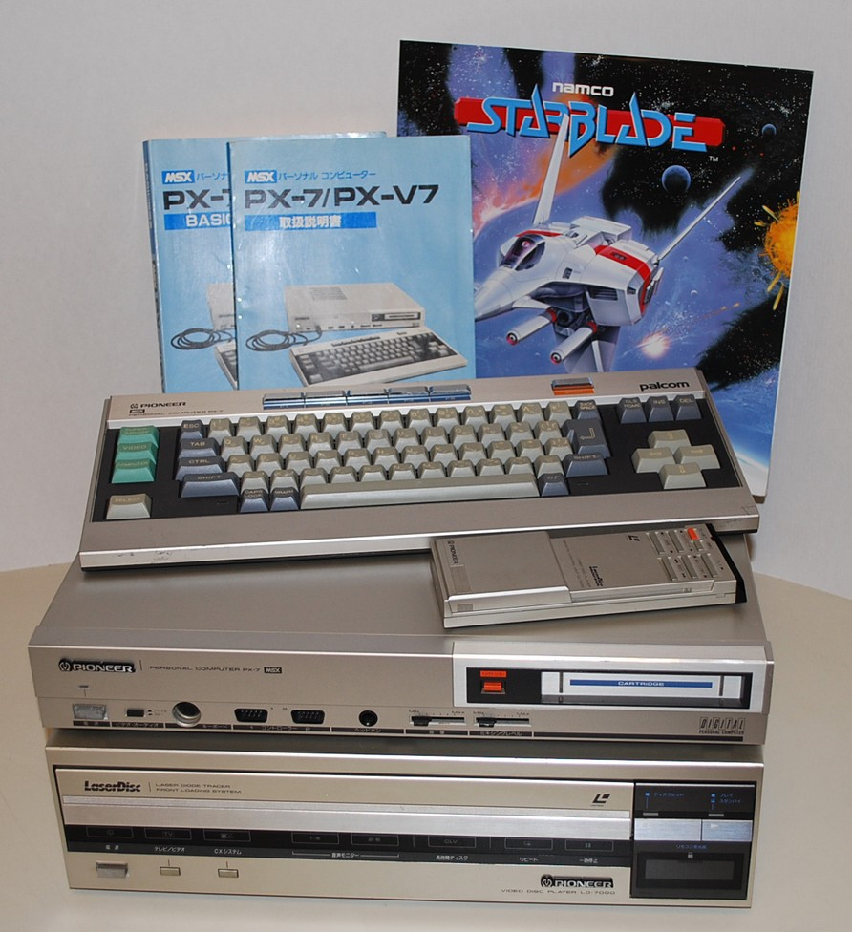
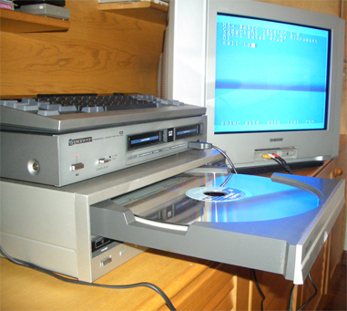
Laserdisc interface
Pioneer Released a MSX Laserdisc interface and several Laserdisc based games.

Slide 40
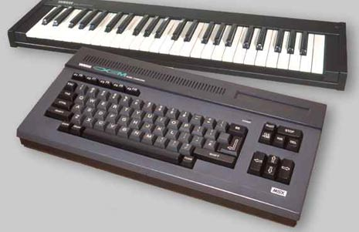
MSX for Music
Yamaha specialized in music oriented MSX models and software.

Slide 41
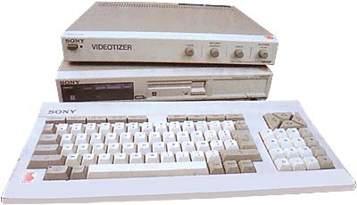
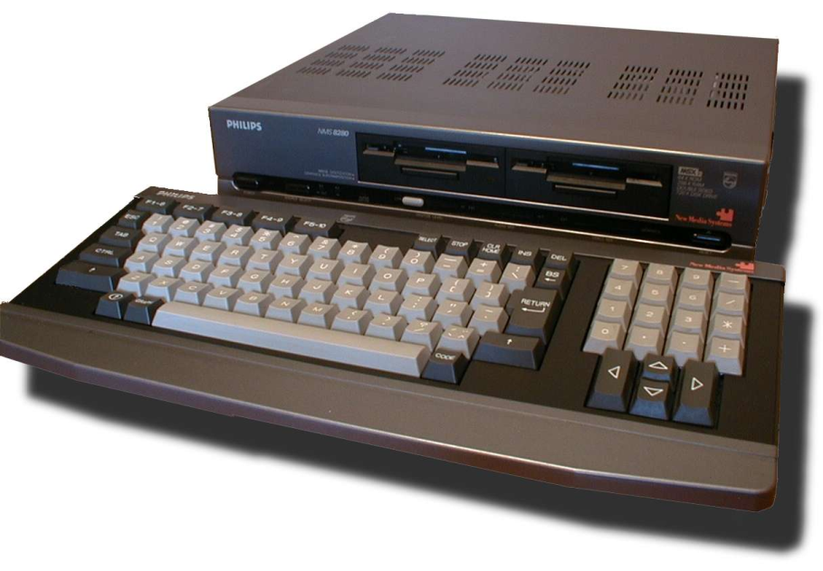
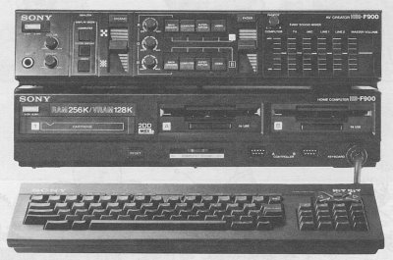
MSX for Video Editing
Sony, Philips, JVC and others produced models dedicated to video editing.

Slide 42
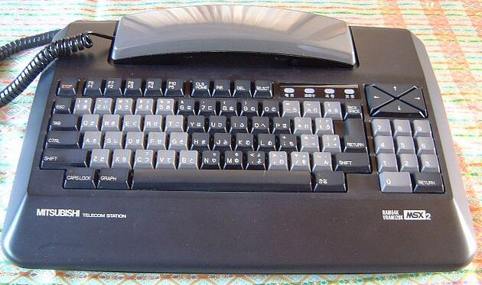
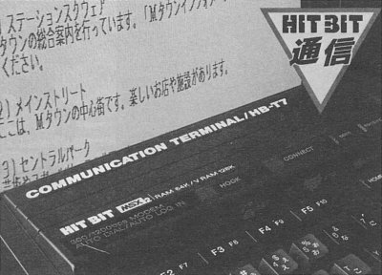
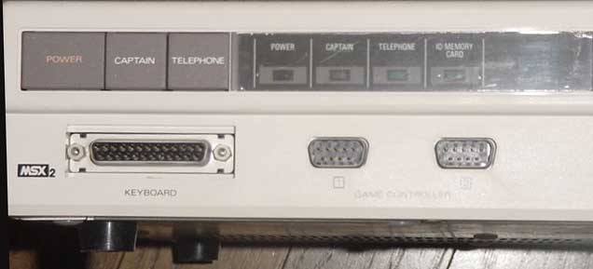
MSX for communication
MSX models dedicated to communication

Slide 43
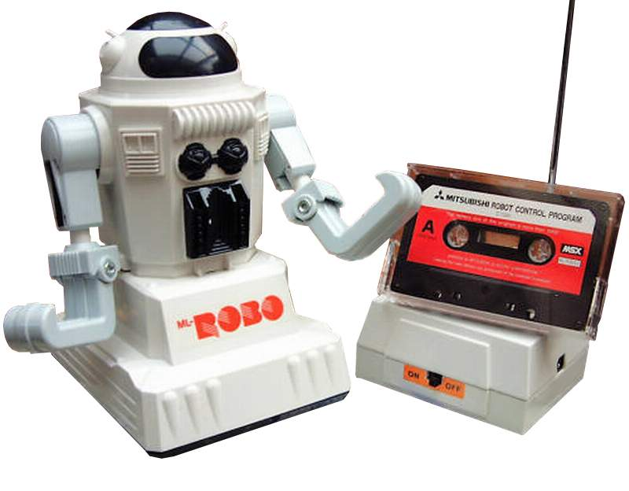
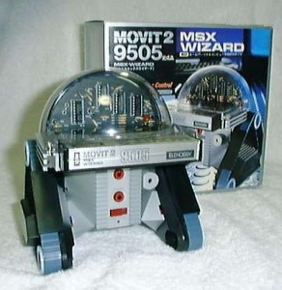
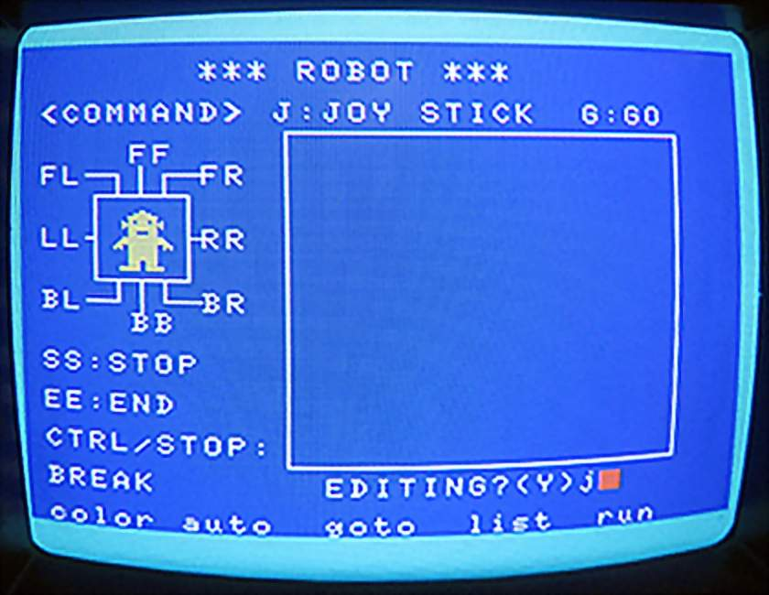
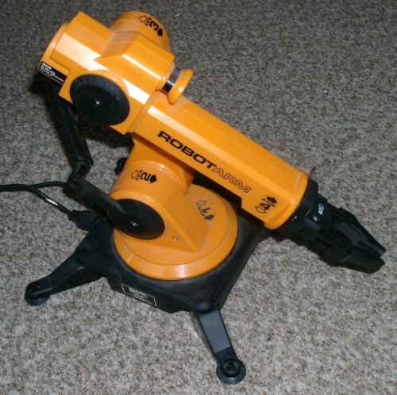


Various MSX Robots

Slide 44


MSX2
MSX 2 was introduced in 1985 with significantly updated graphic specs.
A new display processor, the V9938 designed by Yamaha, replaces the TI9918 while being fully backward compatible.

Slide 45
MSX2 specs
Minimum 64KB of RAM.
Minimum 64KB of dedicated Video RAM (typically 128KB).
80 columns display
512x212/16 colors out of 512.
256x212/256 colors.
Interlaced modes with double vertical resolution.
Enhanced sprites.
Hardware commands for block copy, lines, fill.
Line interrupts management.
A new RAM pagination system (Up to 4MB)
Real time clock chip with rechargeable battery
Enhanced Basic 2.0.

Slide 46


MSX2+ was introduced in 1988 and available only in Japan.
3 brands produced MSX 2+ models: Sony, Sanyo and Panasonic.
The main update is a new graphic processor, the Yamaha V9958.

Slide 47

MSX2+
It features horizontal scrolling capabilities and 3 new screen modes displaying 12499 (YUV) and 19268 (YJK) simultaneously.
Most MSX2+ models also include a built in MSX Music chip with a 9 channel FM synthesizer.
Amateur upgrade kits replacing the VDP and ROMS were available to transform MSX1 and MSX2 into MSX2+.

Slide 48


MSX TurboR
Introduced in 1990 by Panasonic, the TurboR is the last official evolution of the MSX Standard.
The MSX TurboR features a new PCM sound chip and faster CPU designed by ASCII, the R800.

Slide 49



The R800 CPU is backward compatible with the Z80 but provides additional commands.
Its speed is equivalent to a 28.6Mhz Z80, making the TurboR about 8 times quicker than previous MSX generations.

Slide 50

MSX in Japan
MSX was a major success in Japan until 1993 when Panasonic, the last manufacturer of MSX models stopped the production of the TurboR.

Slide 51

MSX in the US
Despite Microsoft’s involvement, MSX were seldom seen and in the United States.
MSX was scheduled to be introduced in the US by mid 1985 but due to the price war led by Commodore Japanese manufacturers cancelled their plans to introduce MSX in the US.
Only Yamaha and Spectravideo distributed some machines.
Yamaha sold their CX5M only through music stores and marketed it as an instrument rather than a home computer.

Slide 52

MSX in Europe
MSX was introduced in Europe in 1984.
It was very popular in the Netherlands, Spain and some other countries.
Sony and Philips were the most active brands supporting MSX in Europe.

Slide 53


MSX in Europe
Philips developed numerous MSX 1 and MSX 2 models as well numerous expansions.
Other European brands like Schneider, Fenner, Radiola, or Dragon also produced a number of models but those are less common.

Slide 54



Philips MSX CD-ROM interface prototype (1985)

Slide 55


MSX in South Korea
MSX was a popular gaming system in South Korea in the 80’s.
Zemmix produced a number of MSX1, MSX2 and MSX2+ based game consoles and cartridge games.

Slide 56


MSX in South America
MSX was also Successful in south America, especially in Brazil.
Two local brand produced MSX models:
  Hotbit (based on Japanese Sharp models)
  Gradiente (Based on Panasonic models)

Slide 57

MSX in South America
MSX were also produced in Argentina under the Talent Brand and commonly used in classrooms.
Most Talent MSX are based on Korean Daewoo MSX1 and MSX2 models.

Slide 58


MSX in the Middle East
MSX was distributed in the middle east by Kuwait-based Al-Alamiah Electronics.
Arab specific software were developed via its Sakhr Software division.
A range of localized Arabic software led many companies — and even government ministries — to adopt MSX as opposed to other, more expensive computer systems and platforms.

Slide 59

MSX in the Middle East
Al-Alamiah/Sakhr MSX models were based on Sanyo, Hitachi and Yamaha MSX1 and MSX2.
All models included a local characters support and dedicated Roms with the “Arabic Basic”.

Slide 60

MSX in the Middle East
Cool facts: Some Sakhr MSX models had a built in Nintendo NES (AX330) or Sega Megadrive (AX660/AX990) with a dedicated Cartridge slot, allowing them to play games from either system.

Slide 61
MSX in USSR
In 1986 Classrooms of networked MSX were used for teaching informatics in school in the Soviet Union.

Slide 62
MSX in Space
One MSX2 machine was even launched into space on board of a Russian MIR space station !
SONY HB-900

Slide 63


Today
Zemmix Neo and the Mini IQ3000
Zemmix Neo (2013)
Mini IQ3000 (2014)

Slide 64

What’s NeXt?

Slide 65
Emulators
Today Emulation makes it possible to play many software titles on modern day PCs and devices, oftentimes offering very close experiences in terms of graphics and sound quality.
Series: Emulators:
  PC-8801 PC88Win, M88, X88000
  PC-9801, PC-9821 Neko Project 2, T98-Next, Anex86
  Sharp X1 Xmillennium
  X68000 WinX68k, XM6
  Fujitsu FM-7, FM-77 XM7’(DASH)
  FM-Towns, FM-Towns Marty Unz
  MSX BlueMSX, OpenMSX, fMSX

Slide 66
Preservation
Today there are some online groups who actively try to catalog and preserve software, firmware and resources for arcade machines, micro-computers, mini-computers and video game consoles.
TOSEC (The Old School Emulation Center)
www.tosecdev.org
MESS (Multi Emulator Super System)
  www.mess.org
Game Preservation Society (Tokyo, Japan)
  www.gamepres.org

